Slide 1
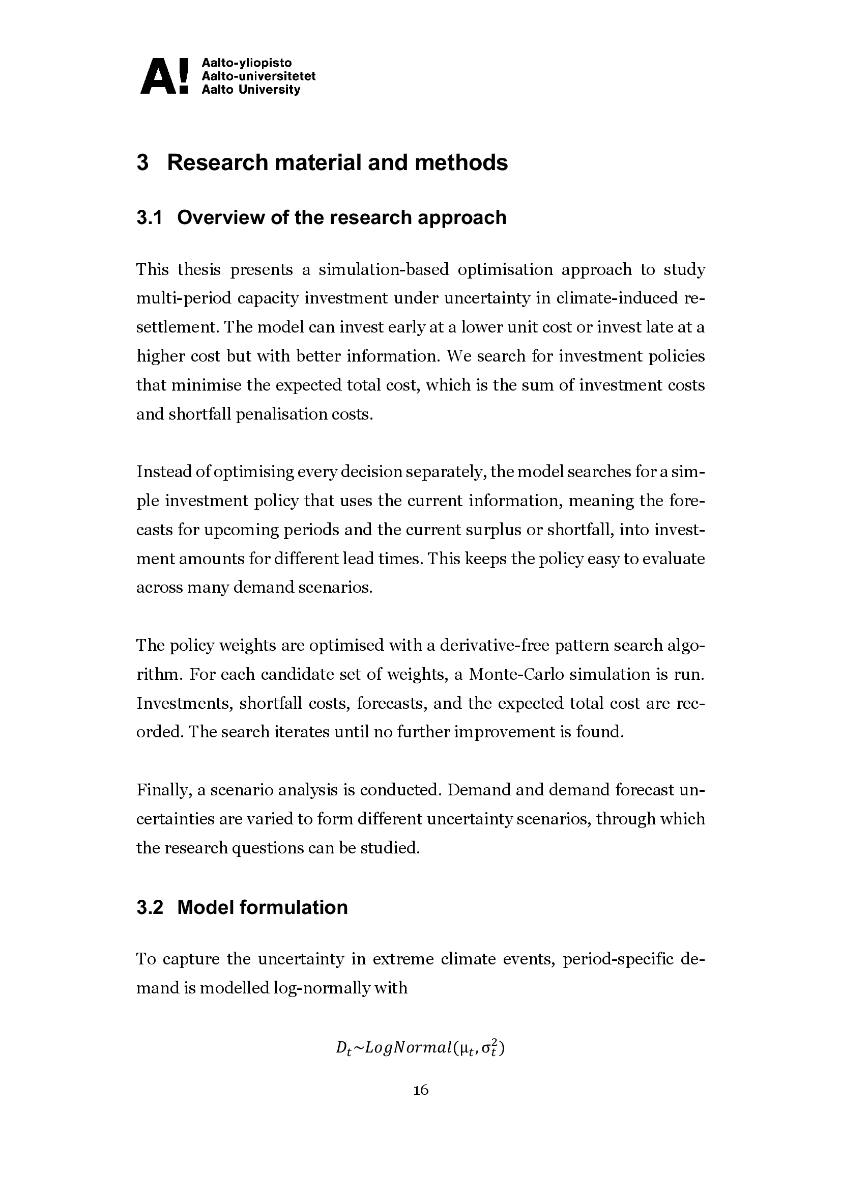
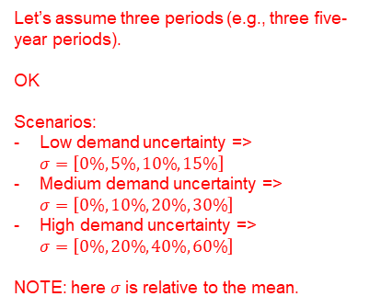
Let’s assume three periods (e.g., three five-year periods).
OK
Scenarios:
Low demand uncertainty => $σ=\left[0\%, 5\%, 10\%, 15\%\right]$
Medium demand uncertainty => $σ=\left[0\%,10\%, 20\%, 30\%\right]$
High demand uncertainty => $σ=\left[0\%,20\%, 40\%, 60\%\right]$
NOTE: here $σ$ is relative to the mean.
Simplification: same expected demand in each period?

Slide 2
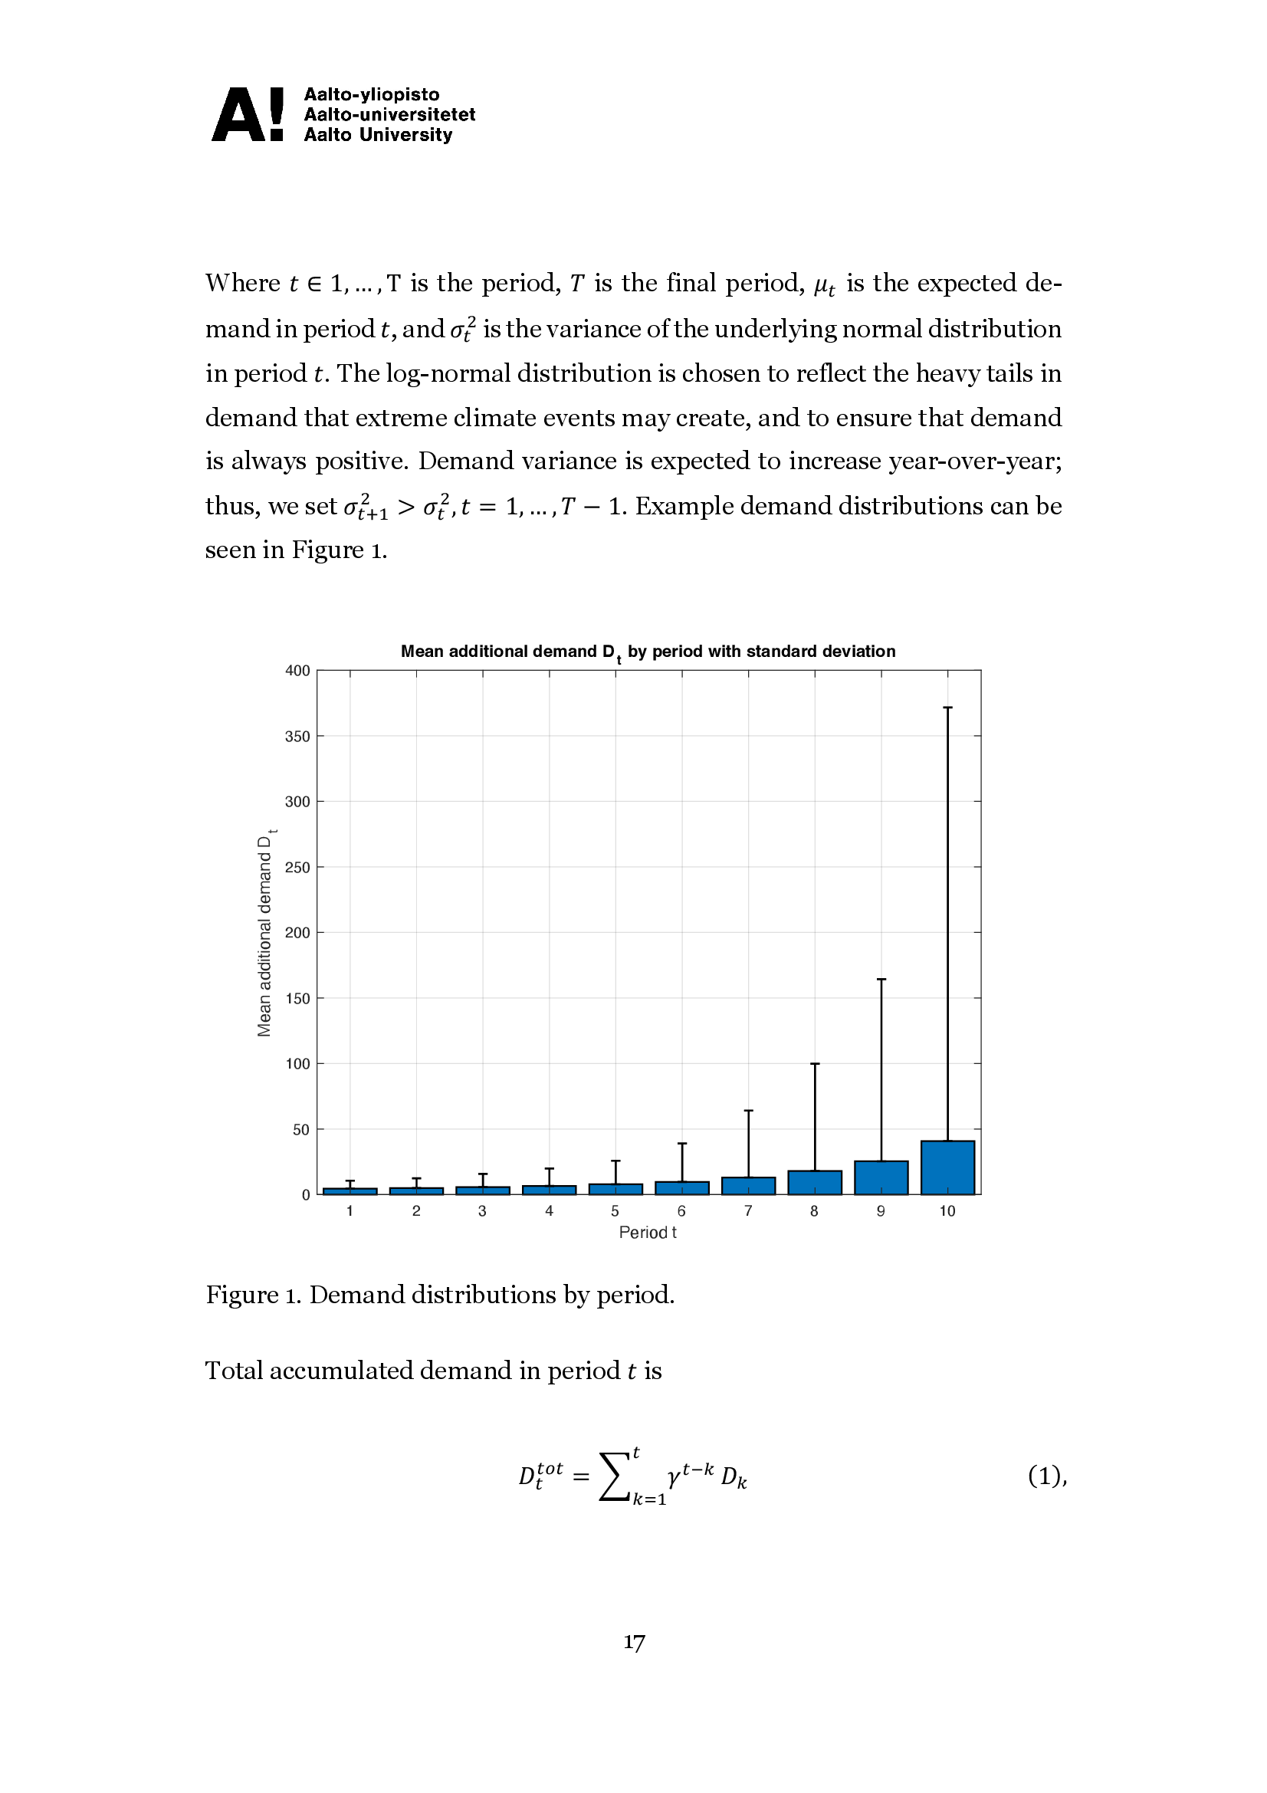

OK
Although, we will likely have to motivate why all demand is not carried over. Is it because people die? Or because the crisis is over quickly (quite unlikely for climate crises).

Slide 3
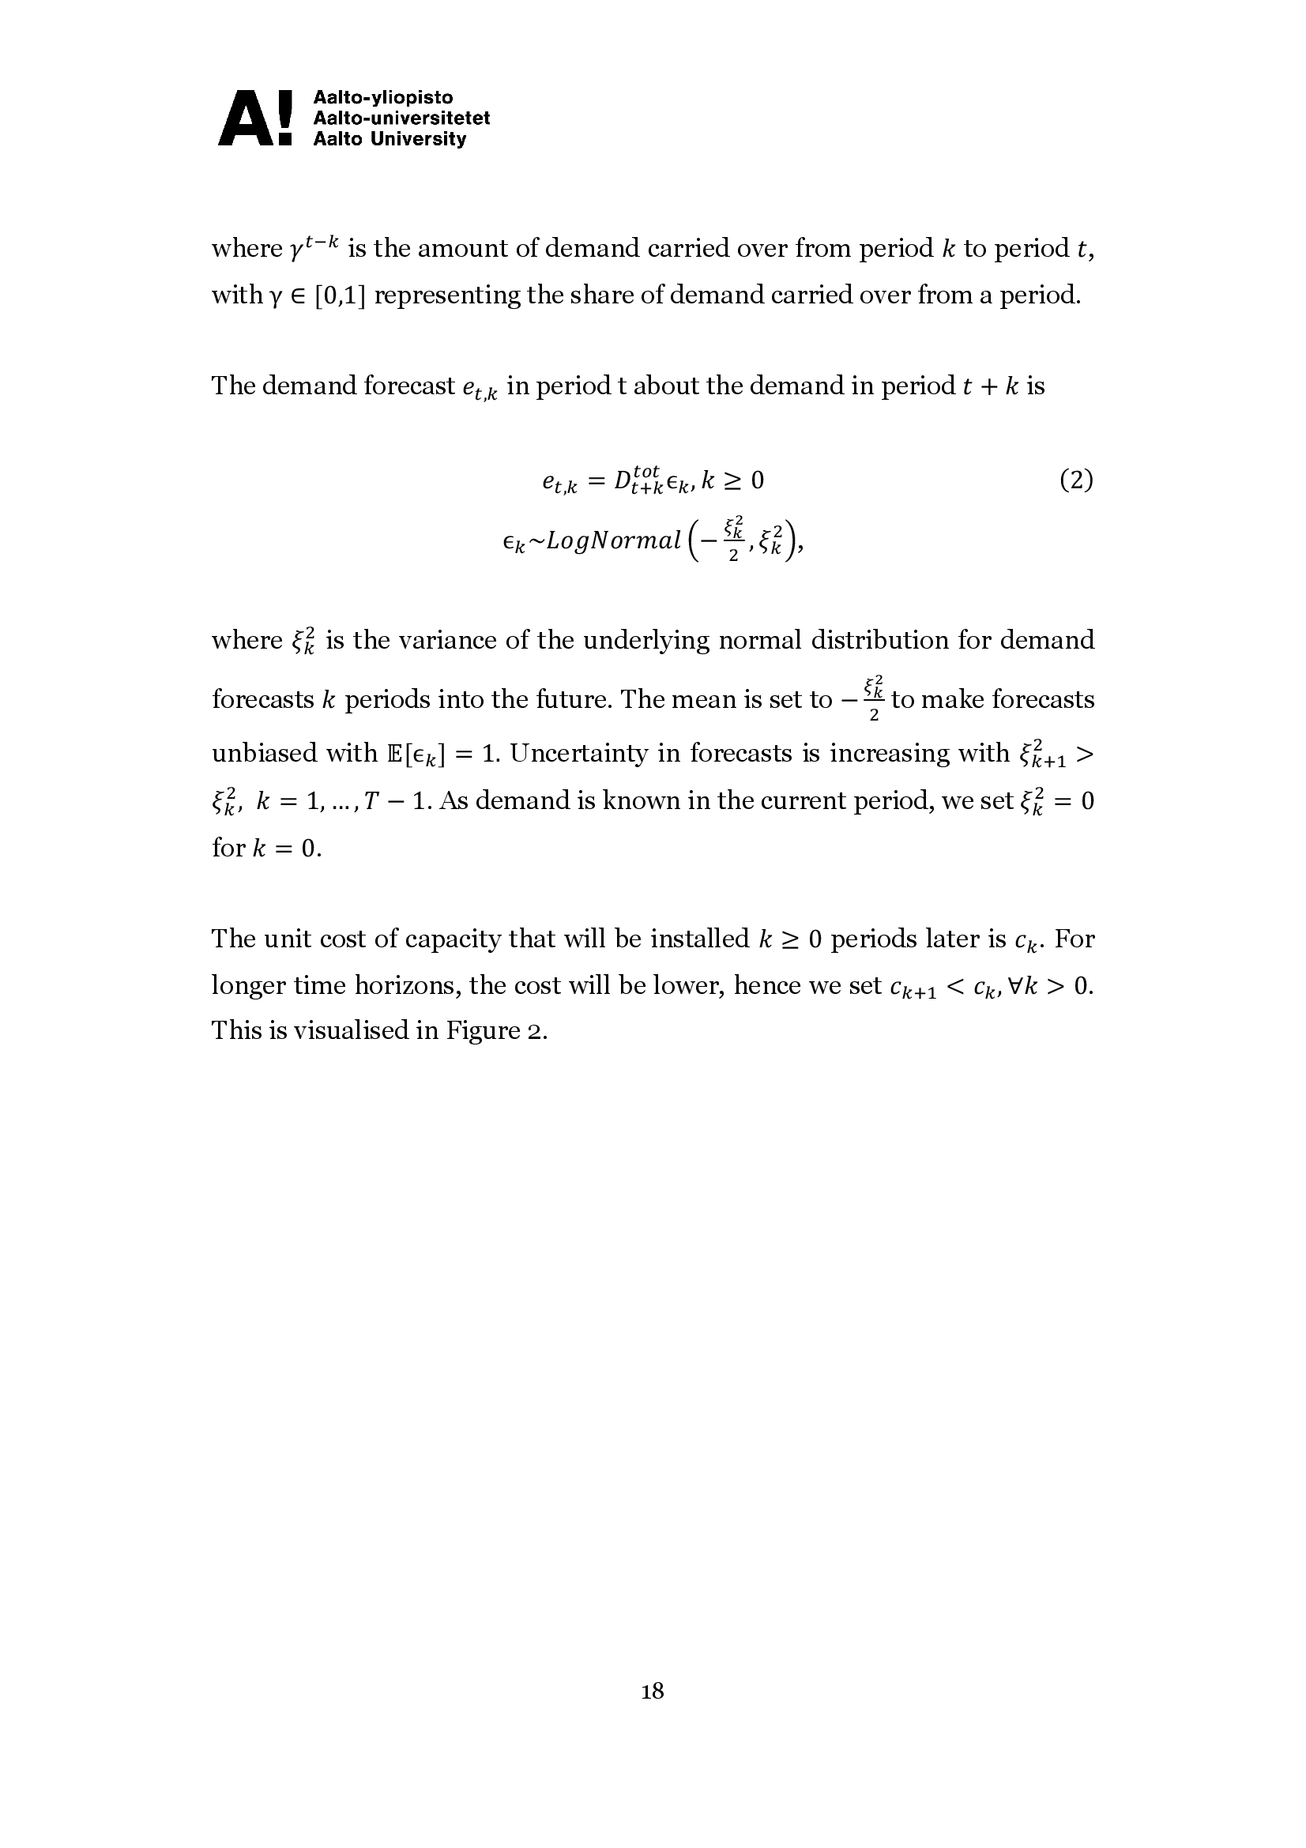
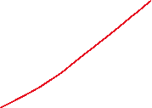

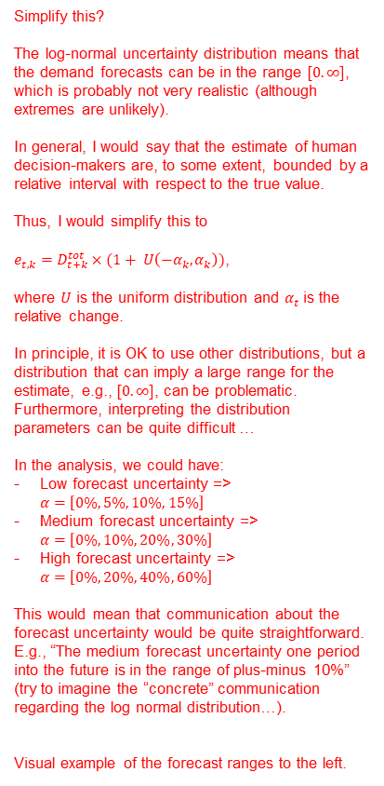
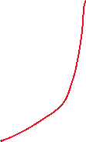
Simplify this?
The log-normal uncertainty distribution means that the demand forecasts can be in the range $[0. ∞]$, which is probably not very realistic (although extremes are unlikely).
In general, I would say that the estimate of human decision-makers are, to some extent, bounded by a relative interval with respect to the true value.
Thus, I would simplify this to
$e_{t,k}=D_{t+k}^{tot}×(1+ U\left(−α_{k}, α_{k}\right))$,
where $U$ is the uniform distribution and $α_{t}$ is the relative change.
In principle, it is OK to use other distributions, but a distribution that can imply a large range for the estimate, e.g., $[0. ∞]$, can be problematic. Furthermore, interpreting the distribution parameters can be quite difficult …
In the analysis, we could have:
Low forecast uncertainty => $α=\left[0\%, 5\%, 10\%, 15\%\right]$
Medium forecast uncertainty => $α=\left[0\%,10\%, 20\%, 30\%\right]$
High forecast uncertainty => $α=\left[0\%,20\%, 40\%, 60\%\right]$
This would mean that communication about the forecast uncertainty would be quite straightforward. E.g., “The medium forecast uncertainty one period into the future is in the range of plus-minus 10%” (try to imagine the “concrete” communication regarding the log normal distribution…).
Visual example of the forecast ranges to the left.
Forecast ranges
(growing)
True total demand

Slide 4
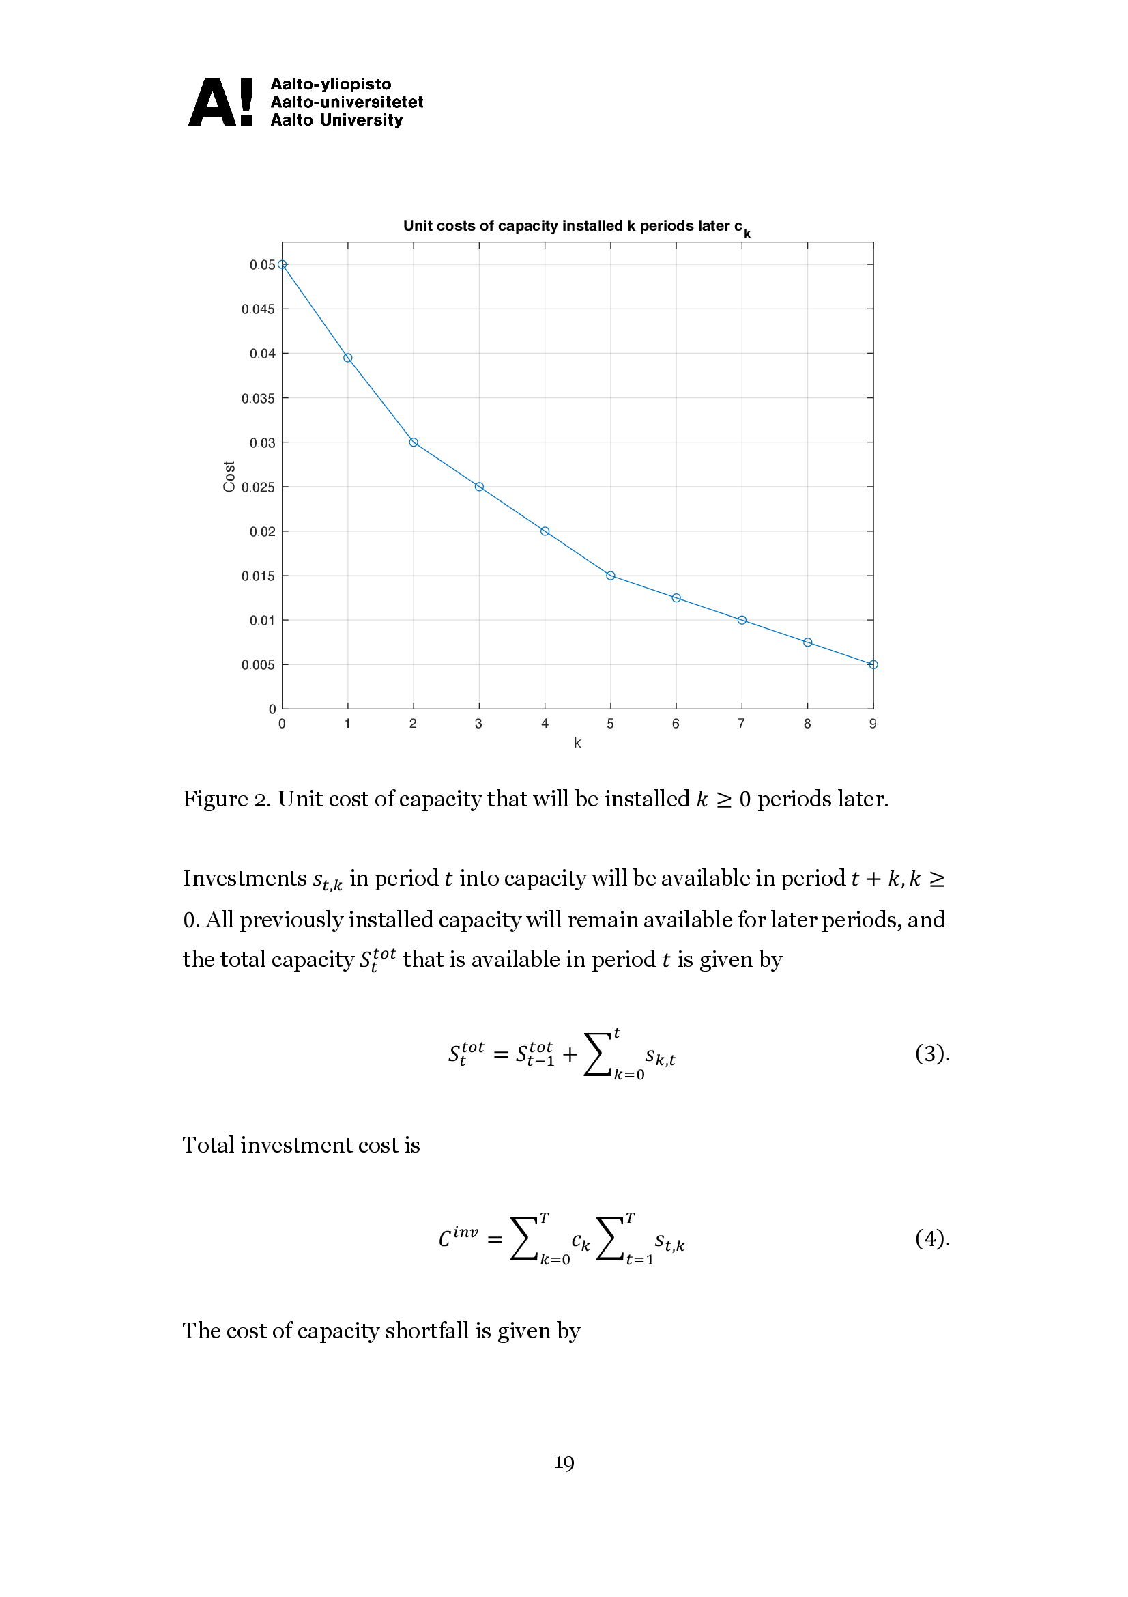
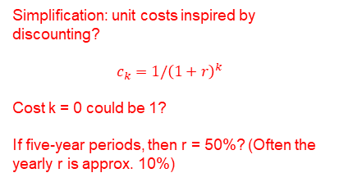
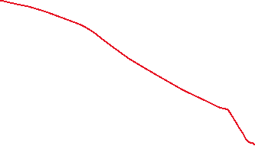
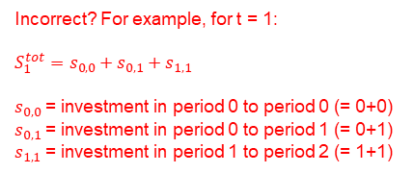


Simplification: unit costs inspired by discounting?
$$c_{k}=1/{\left(1+r\right)}^{k}$$
Cost k = 0 could be 1?
If five-year periods, then r = 50%? (Often the yearly r is approx. 10%)
Incorrect? For example, for t = 1:
$S_{1}^{tot}=s_{0,0}+s_{0,1}+s_{1,1}$
$s_{0,0}$ = investment in period 0 to period 0 (= 0+0)
$s_{0,1}$ = investment in period 0 to period 1 (= 0+1)
$s_{1,1}$ = investment in period 1 to period 2 (= 1+1)
The indexes are incorrect? For example, ${T=10⇒s}_{10,10}$ is the investment in period 10 to period 20?

Slide 5
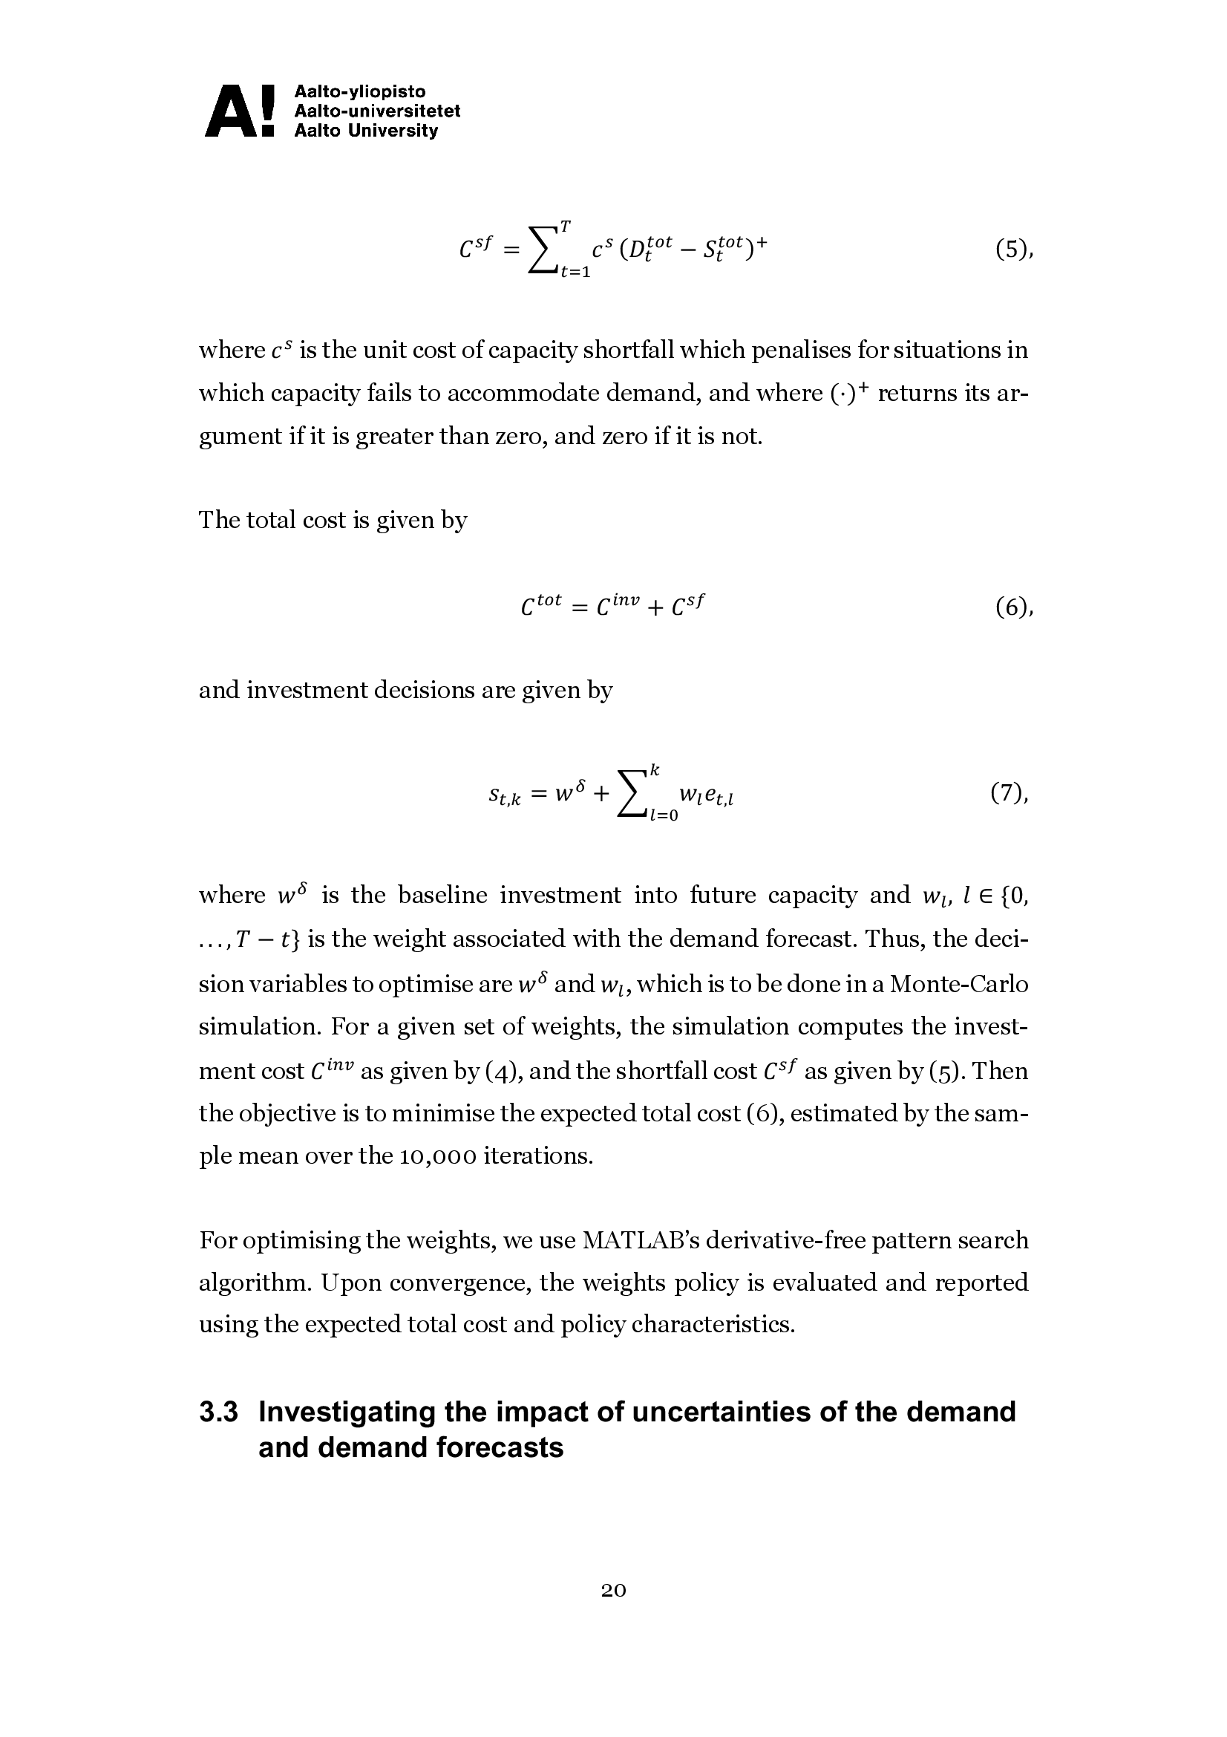
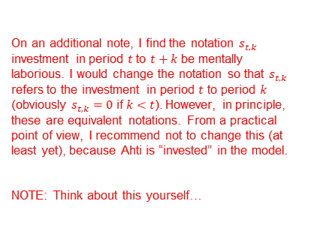
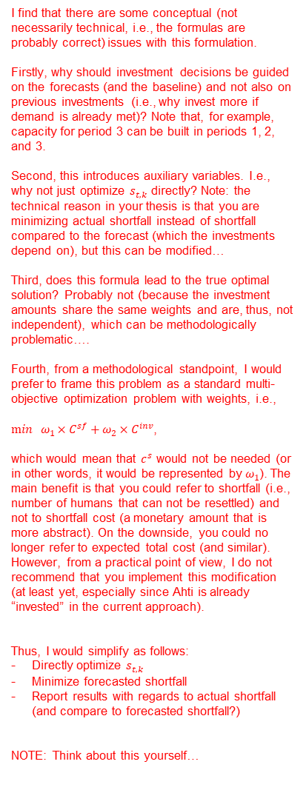
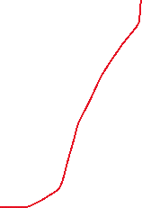
On an additional note, I find the notation $s_{t,k}$ investment in period $t$ to $t+k$ be mentally laborious. I would change the notation so that $s_{t,k}$ refers to the investment in period $t$ to period $k$ (obviously $s_{t,k}=0$ if $k<t$). However, in principle, these are equivalent notations. From a practical point of view, I recommend not to change this (at least yet), because Ahti is “invested” in the model.
NOTE: Think about this yourself…
I find that there are some conceptual (not necessarily technical, i.e., the formulas are probably correct) issues with this formulation.
Firstly, why should investment decisions be guided on the forecasts (and the baseline) and not also on previous investments (i.e., why invest more if demand is already met)? Note that, for example, capacity for period 3 can be built in periods 1, 2, and 3.
Second, this introduces auxiliary variables. I.e., why not just optimize $s_{t,k}$ directly? Note: the technical reason in your thesis is that you are minimizing actual shortfall instead of shortfall compared to the forecast (which the investments depend on), but this can be modified…
Third, does this formula lead to the true optimal solution? Probably not (because the investment amounts share the same weights and are, thus, not independent), which can be methodologically problematic….
Fourth, from a methodological standpoint, I would prefer to frame this problem as a standard multi-objective optimization problem with weights, i.e.,
$\min{ ω_{1}}×C^{sf}+ω_{2}×C^{inv}$,
which would mean that $c^{s}$ would not be needed (or in other words, it would be represented by $ω_{1}$). The main benefit is that you could refer to shortfall (i.e., number of humans that can not be resettled) and not to shortfall cost (a monetary amount that is more abstract). On the downside, you could no longer refer to expected total cost (and similar). However, from a practical point of view, I do not recommend that you implement this modification (at least yet, especially since Ahti is already “invested” in the current approach).
Thus, I would simplify as follows:
Directly optimize $s_{t,k}$
Minimize forecasted shortfall
Report results with regards to actual shortfall (and compare to forecasted shortfall?)
NOTE: Think about this yourself…

